Slide 1
Enhancements and Standardization
to KYTC Regional Models
Presented to
The Kentucky Model Users Group
Presented by
The Corradino Group
Frankfort, KY
April 18, 2016

Slide 2
Outline
KYTC’s Standardized Procedures for Regional Models
TAZ
Network flexibility
2 Truck Class Model
TOD functionality
Input BIN files
Traffic Assignment
Model Reporting
KYTC’s
Regional Models

Slide 3
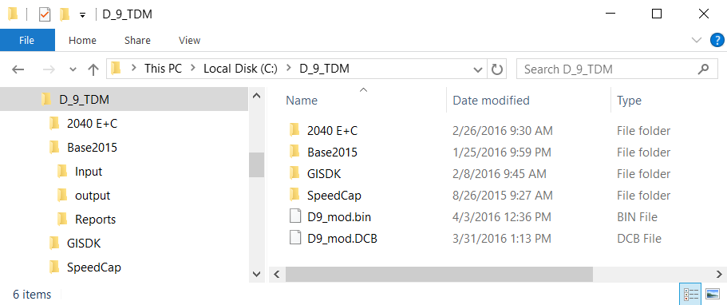
KYTC’s Standardization of Regional TDM
KYTC has developed a standardized travel demand modeling procedure. The District 9 regional model is the latest to use the procedure.
1. Standardized Organization of Model Files

Slide 4
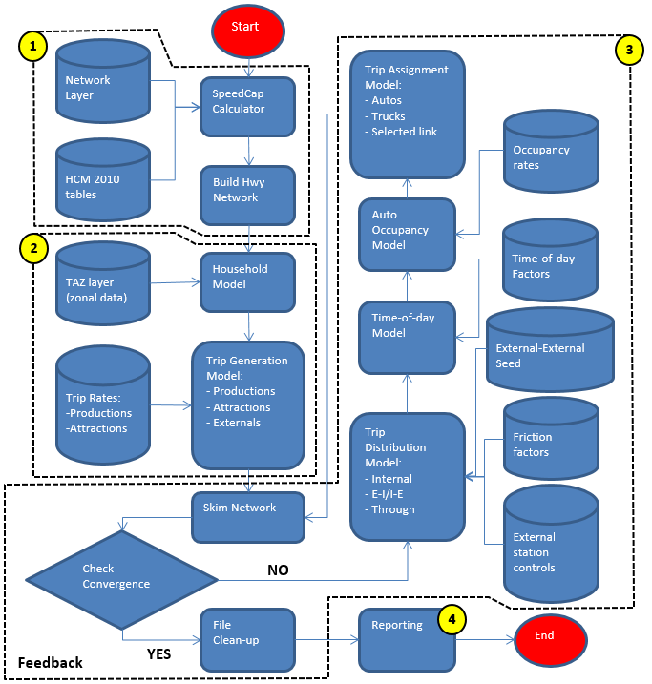
Standard flow of Regional TDMs
2. Standardized Model Stream
Same framework for regional models
Identified methodologies for sub-models (e.g., 2010 HCM speed/capacity calculator, NCHRP 716 external trip model)
TAZ/Network coding & fields requirement
KYTC’s default traffic assignment & feedback loop parameters (e.g., # of iterations, assignment convergence criteria)
KYTC’s highway assignment validation targets
Flexible application of AirSage and other useful data sources for enhancing sub-models or model parameters

Slide 5
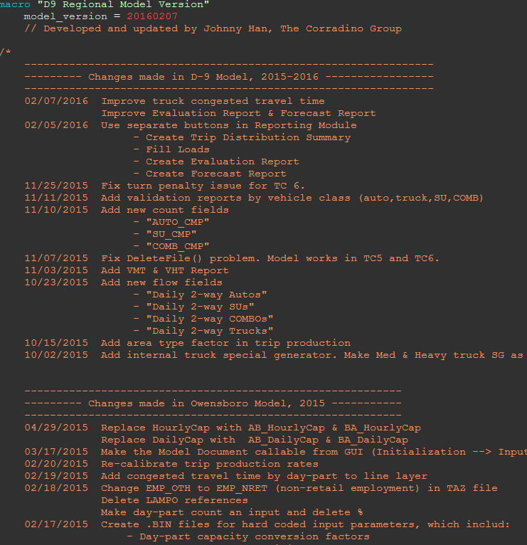
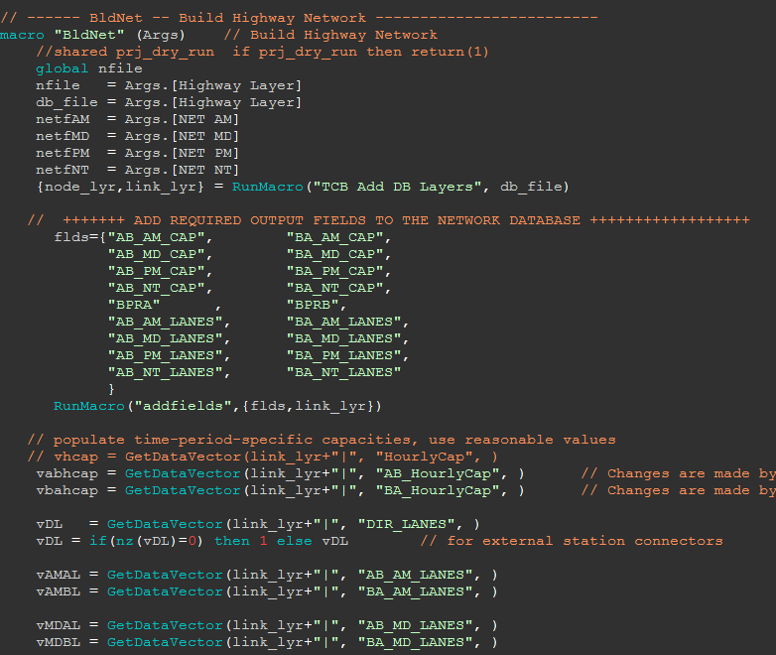
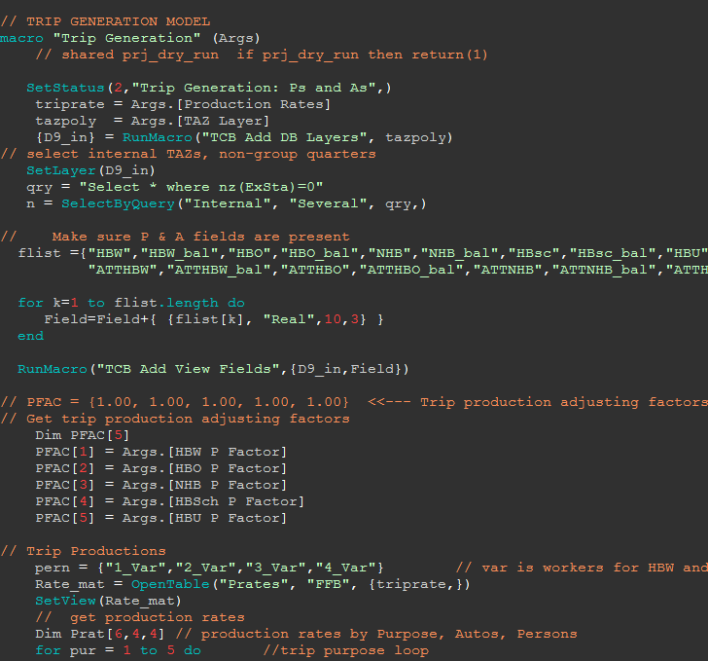
Standardization Script for Regional TDMs
3. Standardized Model Script
Standardized macros for all model components
Standard variable names
Minimal hard-coded parameters (parameters saved in input BIN file)
Track and Date of script changes

Slide 6
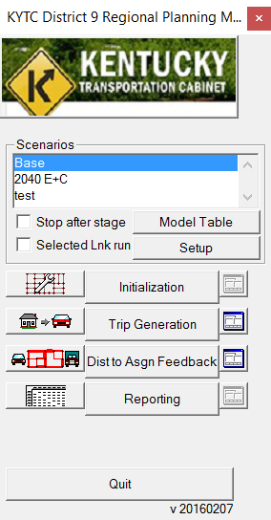
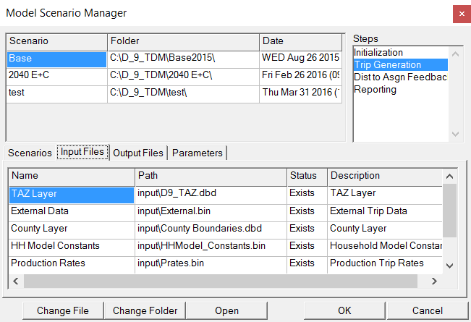
Standardized Interface of Regional TDM
4. Standardized Model Dialogue
Model step controlled in main GUI
Model Scenario Manager to manage scenarios, input, output & parameters

Slide 7
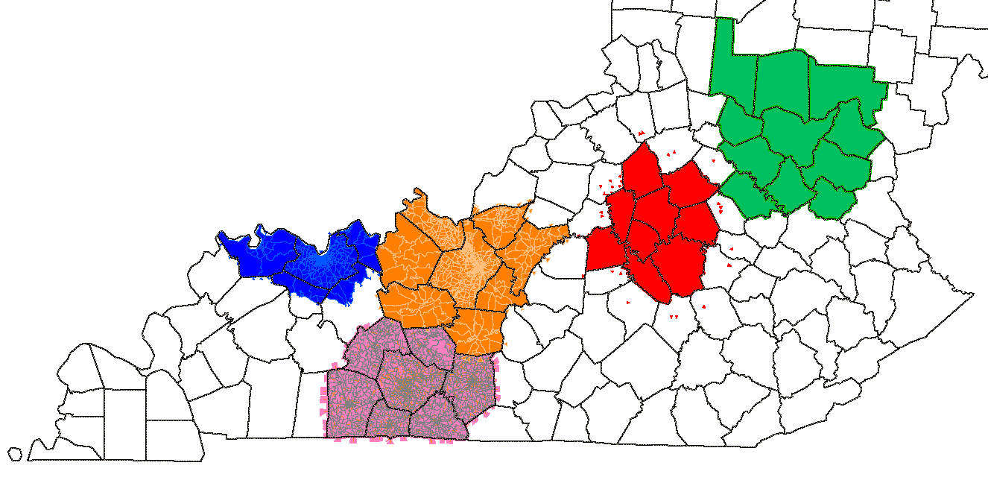
KYTC’s Completed Regional Models
Lexington/Central KY Region (2012)
Owensboro/Henderson Region (2014)
Bowling Green/Warren Co. (2014)
E-town/Hardin Co./Meade Co. (2014)
KYTC District 9 Regional Model (2015)
District 9
Lexington
Owensboro
Elizabethtown
Bowling Green

Slide 8
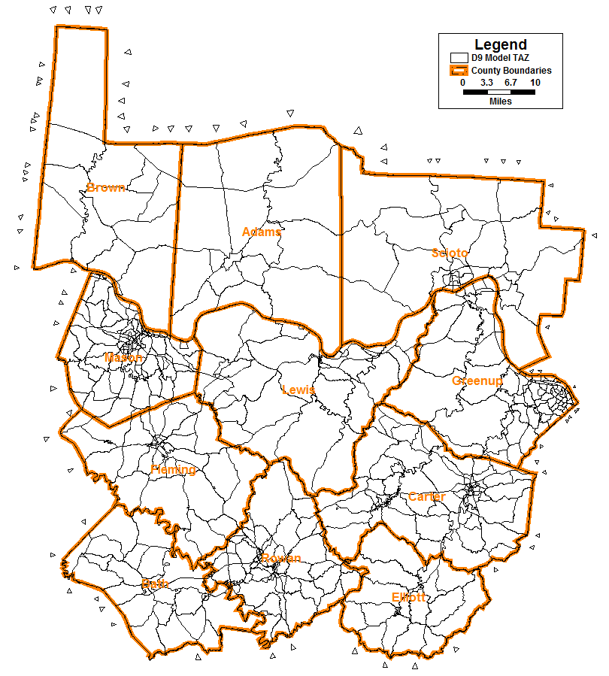
Regional Model – TAZ Structure
Ease in splitting zones (internal & external)
Zones nest within KYSTM TAZs
Generally conforms to census block boundary
Zones approach homogeneous land use
Incorporating adjacent counties to be sensitive to movement & external trips across Kentucky’s boundary
Zone numbering to improve spatial understanding of tabular maintenance & updates
County | # of TAZ | ID Range
Bath | 38 | 8000+
Carter | 99 | 2000+
Elliott | 26 | 3000+
Fleming | 50 | 7000+
Greenup | 84 | 1000+
Lewis | 55 | 4000+
Mason | 117 | 6000+
Rowan | 91 | 5000+
Adams | 16 | 10000+
Brown | 14 | 9000+
Scioto | 30 | 11000+
External Zone | 74 | 15001 - 15074
Total | 694

Slide 9
Regional Model – Zonal Data
Household & Population – 2010 census, KDC for future scenarios.
Employment by type (service, retail, non-retail)
KY zones – geocoded ES202 & Non-KY zones– LEHD data (census block)
Vehicle ownership
KY zones – geocoded vehicle registration
Non-KY zones – US census (block group)
K-12 enrollment – Education Cabinet & KDC for future scenarios
College enrollment - by college
Workers, students (at home location) & Income – US Census
Area type – Claritas Based initially on KYSTMv10
Special fields for +/- adjust for SU & COMB truck trips

Slide 10
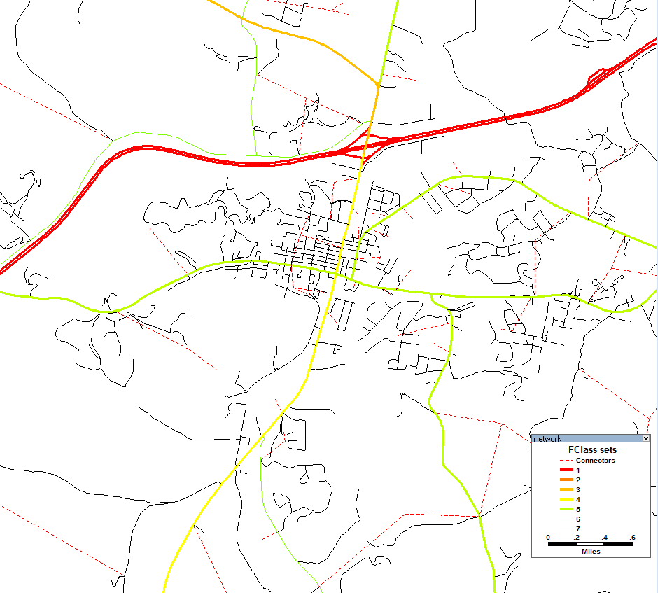
Regional Model – Network
Networks include all Roads

Slide 11
Regional Model – Networks
Based on KYTC’s Highway Information System (HIS) and roadway layers from other states. KY HIS field names retained as possible.
Ultimate goal is for All roads to have minimal model attributes for a successful model run. (when In_Network>0)
Inactive: In_Network = null or 0 (not included for skimming & assignment)
Active for auto & truck: In_Network = 1
Active for auto only: In_Network = 2
Active for truck only: In_Network = 3
Active links include all roads with FC = Minor Collector or above and key local roads.
Free-flow Speed & Hourly Capacity based on HCM 2010
Speed_Override and Directional HrlyCap_Override fields.

Slide 12
Regional Truck Model
Regional Truck Model Components
Single-unit truck (SU truck, FHWA class 4-7)
Freight combination truck (COMB truck, FHWA class 8-13)
FHWA class 3 (4-tire truck, e.g., pickups & vans) are merged into auto trips
For KYTC’s early review, truck models are developed first as soon as the model’s TAZ /Network data is ready.

Slide 13
Regional Truck Model – Time of Day
Truck Time-of-Day (TOD) Factors
Initially from KYTC’s SU & COMB truck counts
Rates are adjusted to balance time periods to counts
Values are stored in the TOD.bin file
Truck Type | TOD Factor
 | AM | MD | PM | NT
Internal Light (add to autos) | 0.1851 | 0.4160 | 0.2019 | 0.1970
Internal SU | 0.1851 | 0.4160 | 0.2019 | 0.1970
Internal Comb | 0.1436 | 0.3918 | 0.1914 | 0.2732
EI_SU | 0.1851 | 0.4160 | 0.2019 | 0.1970
EI_Comb | 0.1436 | 0.3918 | 0.1914 | 0.2732

Slide 14
Regional Truck Model – Assignment
Volume Group | Flow | Count | % RMSE | Flow/Count Ratio
0 - 2,000 | 167,891 | 159,756 | 50.9% | 1.051
2,000 - 5,000 | 8,741 | 9,148 | 16.0% | 0.956
Total | 176,632 | 168,904 | 49.2% | 1.046
Area Type | Flow | Count | % RMSE | Flow/Count Ratio
Rural | 98,719 | 99,279 | 42.6% | 0.994
Town | 64,434 | 59,419 | 48.5% | 1.084
Second City | 13,479 | 10,206 | 66.0% | 1.321
Total | 176,632 | 168,904 | 49.2% | 1.046
Functional Class | Flow | Count | % RMSE | Flow/Count Ratio
Interstate | 27,254 | 30,532 | 14.4% | 0.893
Other Frwy/Expwy | 1,005 | 1,203 | 28.4% | 0.835
Principal Arterial | 72,107 | 71,415 | 38.6% | 1.010
Minor Arterial | 41,619 | 36,896 | 56.3% | 1.128
Major Collector | 32,942 | 27,809 | 89.3% | 1.185
Minor Collector | 1,277 | 883 | 120.2% | 1.446
Total | 176,632 | 168,904 | 49.2% | 1.046
County | Flow | Count | % RMSE | Flow/Count Ratio
Bath | 12,658 | 11,346 | 33.7% | 1.116
Carter | 23,035 | 24,991 | 31.4% | 0.922
Elliott | 1,065 | 1,023 | 51.4% | 1.041
Fleming | 7,456 | 8,451 | 28.8% | 0.882
Greenup | 26,093 | 24,541 | 40.0% | 1.063
Lewis | 4,686 | 5,589 | 60.7% | 0.838
Mason | 17,863 | 17,533 | 44.8% | 1.019
Rowan | 16,667 | 15,482 | 50.5% | 1.077
Adams | 11,984 | 9,050 | 93.2% | 1.324
Brown | 14,999 | 13,715 | 42.0% | 1.094
Scioto | 40,030 | 37,111 | 55.9% | 1.079
Total | 176,632 | 168,904 | 49.2% | 1.046
Global truck attractions are in the Arates.bin file:
By MED/HEAVY (SU/COMB)
By Household & Employment (Basic/Retail/Service)
Tip: When adjusting rates, focus on County with greatest truck counts

Slide 15
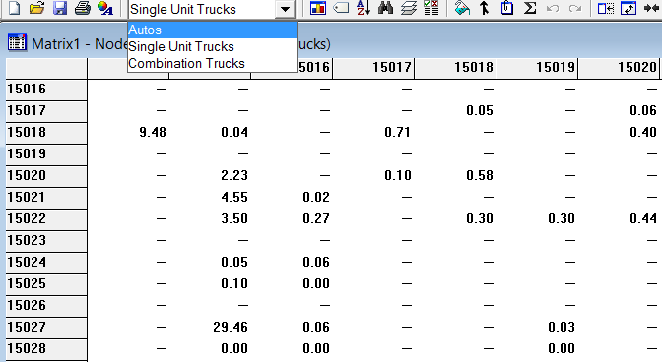
External Trip factors
Final External Trip factors establish E-E/E-I splits & an EE seed trip table by vehicle class (Auto, SU truck, COMB truck) through a sub-area extraction of KYSTMv10.
External trip table resides in the Externals.bin file. E-E seed trip table resides in the ee_seed.mtx file.

Slide 16
Regional Model – Trip Generation
Internal Trip Purpose – HBW, HBO, NHB, HBSch, HBU, Light truck, SU truck, COMB truck
Trip Rates are initially base on existing calibrated models. Final rates are ultimately unique to the region. Rates are kept in the Prates.bin file
Production Rates
Attraction Rates
Purpose | Vehicle Class | 0 Worker | 1 Worker | 2 Worker | 3+ Worker
HBW | 0 Veh | 0.00 | 1.10 | 2.64 | 5.61
 | 1 Veh | 0.00 | 1.10 | 2.86 | 5.61
 | 2 Veh | 0.00 | 1.43 | 2.86 | 5.61
 | 3+ Veh | 0.00 | 1.43 | 2.86 | 5.61
Purpose | Vehicle Class | 1 Person | 2 Person | 3 Person | 4+ Person
HBO | 0 Veh | 0.86 | 2.16 | 3.24 | 5.24
 | 1 Veh | 1.37 | 2.52 | 4.46 | 5.79
 | 2 Veh | 1.44 | 2.59 | 4.46 | 6.26
 | 3+ Veh | 1.44 | 2.59 | 4.46 | 6.71
Purpose | Vehicle Class | 1 Person | 2 Person | 3 Person | 4+ Person
NHB | 0 Veh | 0.50 | 1.22 | 1.44 | 2.71
 | 1 Veh | 1.01 | 1.66 | 2.52 | 2.81
 | 2 Veh | 1.15 | 1.87 | 2.81 | 3.99
 | 3+ Veh | 1.15 | 1.94 | 3.24 | 4.52
Purpose | Vehicle Class | Total Households
HBSchool | All Class | 1.81
Purpose | Vehicle Class | Total Households
HBU | All Class | 1.21
Purpose | HH | Basic Emp. | Retail Emp. | Service Emp. | Total Emp. | Univ. Enroll. | K-12 Enroll.
HBW |  |  |  |  | 2.244
HBO | 1.00 | 0.30 | 5.90 | 2.30
NHB | 0.78 | 0.91 | 3.38 | 1.30
HBSchool |  |  |  |  |  |  | 1.46
HBU |  |  |  |  |  | 1.39

Slide 17
Regional Model – Trip Generation
E-I Trip Generation (auto, SU truck, COMB truck)
Production – traffic counts
Attraction – NCHRP 716 (assume no I-E trips for an area with rural boundary)
$E_{j}$ = EI trips generated in internal TAZ j
$T_{j}$ = total internal attractions for TAZ j
$D_{j}$ = distance from TAZ j to the nearest external station (by station type)
A,B = calibrated parameters
$E_{j}=AT_{j}D_{j}^{B}$
Coefficient | Purpose | External Station Type
 |  | Frwy & Expwy | Arterial near Expwy | Arterial Not Near Expwy | Collector & Local
A | EI_Auto | 0.2061 | 0.5636 | 1.5246 | 0.3658
 | EI_SU | 0.1877 | 0.5452 | 1.5396 | 0.3329
 | EI_Comb | 1.4680 | 1.7974 | 1.7796 | 0.4598
B | EI_Auto | -1.0000 | -1.2850 | -1.5170 | -1.4820
 | EI_SU | -1.0000 | -1.1565 | -1.3653 | -1.3338
 | EI_Comb | -1.0000 | -1.0280 | -1.2136 | -1.1856
Parameters A & B resides in EI_Coefficient.bin file.

Slide 18
Regional Model – Time of Day Factors
Time-of-Day (TOD): AM Peak, Mid-day, PM Peak, Night
Trip Purpose | TOD Factor |  |  |  | D Factor (P to A)
 | AM | MD | PM | NT | AM | MD | PM | NT
HBW | 0.2075 | 0.3149 | 0.2260 | 0.2516 | 0.9412 | 0.4901 | 0.1576 | 0.3903
HBO | 0.1214 | 0.3439 | 0.2190 | 0.3158 | 0.8487 | 0.5410 | 0.4172 | 0.3446
NHB | 0.1350 | 0.4136 | 0.2454 | 0.2059 | 0.5000 | 0.5000 | 0.5000 | 0.5000
HBSchool | 0.3962 | 0.2953 | 0.3085 | 0.0000 | 0.9937 | 0.2851 | 0.1282 | 0.1714
HBU | 0.3683 | 0.2744 | 0.2867 | 0.0706 | 0.9937 | 0.2851 | 0.1282 | 0.1714
EI_Auto | 0.1403 | 0.3469 | 0.2299 | 0.2830 | 0.8487 | 0.5410 | 0.4172 | 0.3446
EE | 0.1345 | 0.3632 | 0.2281 | 0.2743 | 0.5000 | 0.5000 | 0.5000 | 0.5000
TOD factors of HBW, HBO, NHB & EE initially from AirSage. TOD factors of HBSchool & HBU initially from NCHRP 716. Adjustments are required. Models assume no HBSchool trips at night period.
Directional factors are directly from AirSage PA tables or NCHRP 716.
TOD factors are in the TOD.bin file

Slide 19
Regional Model – Auto Occupancy Rates
Purpose | AM Peak | Mid-day | PM Peak | Night
HBW | 1.05 | 1.06 | 1.07 | 1.06
HBO | 1.69 | 1.81 | 1.69 | 1.81
NHB | 1.43 | 1.78 | 1.65 | 1.78
HBSchool | 1.90 | 1.90 | 1.90 | 1.90
HBU | 1.14 | 1.14 | 1.14 | 1.14
Auto occupancy rates are kept in the Occupancy.bin file.

Slide 20
Regional Model – Assignment
User Equilibrium (UE) algorithm
For each time period, trucks are pre-assigned on an all-or-nothing basis while autos are assigned using BPR function and truck PCE=1.5. Convergence criteria = 0.0001.
TOD flow is sum of all loaded vehicles for each time period. TOD flows are then summed to get daily flows.
Trip distribution to assignment feedback loop. The MSA (method of successive average) process is used to determine convergence. Convergence is achieved when RMSE% < 1% for travel time matrices between current and successive iterations.
Notes:
A method developed to save pre-calculated skim to save model running time?

Slide 21
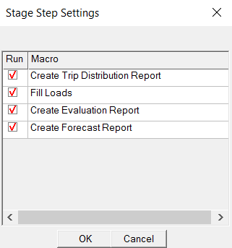
Regional Model - Reporting
Reports are stored in a .xml file
Report has a table of contents. Easy to copy to Excel/Word without re-format
It will take longer to open the file after several model runs. (Can rename the file)
Trip zonal data summary
Trip distribution summary
Highway assignment summary
Assignment validation report
System performance report
Check for base year
Check for future year
User can control assignment report generation in model interface. For the base year, check “Create Evaluation Report” button to generation both validation & system performance reports. For a future year, check “Create Forecast Report” button to only generate system performance report.

Slide 22
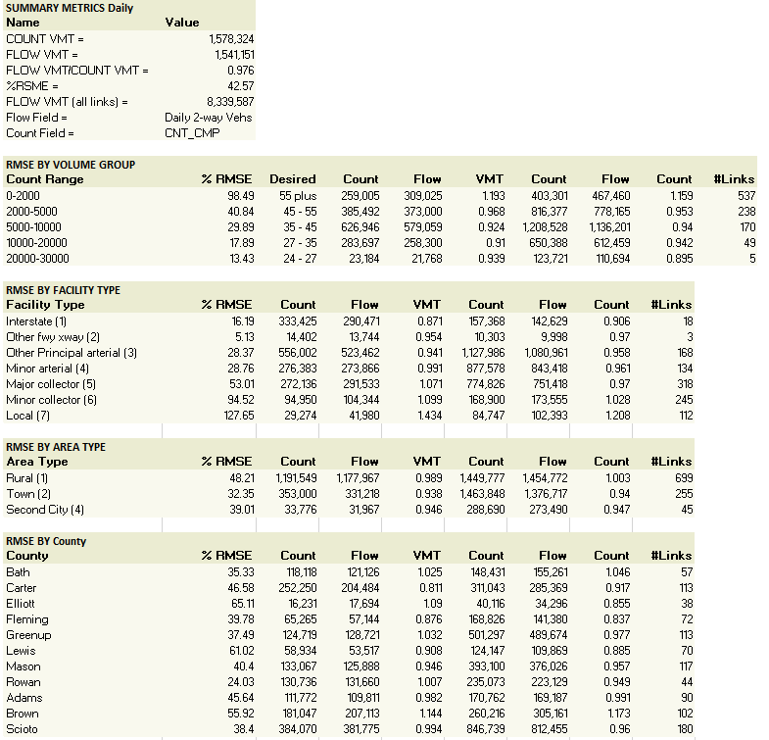
Regional Model – Validation Report
Example Report
Reports by
Daily
Each time period
Vehicle class (auto, SU truck, COMB truck, total truck, total vehicle)
Each series includes
Summary statistics
RMSE by volume group
RMSE by facility type
RMSE by area type
RMSE by county
Screenline analysis (only for total vehicle)

Slide 23
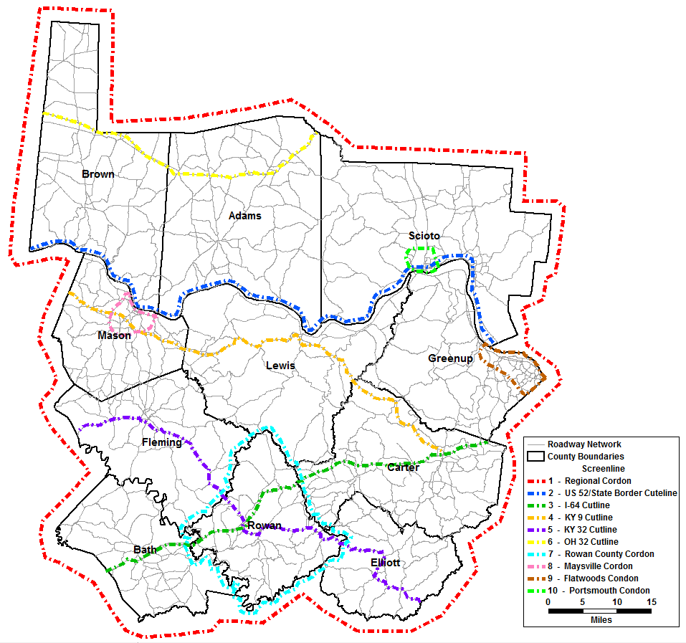
Regional Model – Assignment Validation
Screenline | Model Volume | Traffic Counts | Deviation% | Max Desired Deviation%
1 – Regional Cordon | 260,511 | 253,794 | 2.6% | 17.4%
2 – US 52/State Border Cutline | 137,789 | 113,757 | 21.1% | 23.6%
3 – I-64 Cutline | 117,139 | 122,982 | -4.8% | 22.9%
4 – KY 9 Cutline | 67,205 | 70,751 | -5.0% | 28.3%
5 – KY 32 Cutline | 94,666 | 101,249 | -6.5% | 24.7%
6 – OH 32 Cutline | 45,561 | 38,305 | 18.9% | 35.8%
7 – Rowan County Condon | 36,400 | 35,374 | 2.9% | 36.9%
8 – Maysville Cordon | 46,963 | 46,385 | 1.2% | 33.2%
9 – Flatwoods Condon | 65,844 | 69,708 | -5.5% | 28.5%
10 – Portsmouth Condon | 92,076 | 86,065 | 7.0% | 26.3%
Screenline results are automatically reported.

Slide 24
Regional Model – Assignment Validation
Time-of-Day Assignment
Volume Group | RMSE %
 | AM | MD | PM | NT | Target Range
0 - 2,000 | 55.0% | 62.8% | 53.5% | 58.5% | > 55%
2,000 - 5,000 | 36.5% | 28.9% | 23.2% | 25.2% | 45 - 55%
5,000 - 10,000 | n/a | 14.2% | n/a | n/a | 35 - 45%
Model VMT/Count VMT | 1.010 | 0.955 | 0.938 | 0.963
TOD assignment is automatically reported by
Volume Group
Functional Class
Area Type
County
Screenline

Slide 25
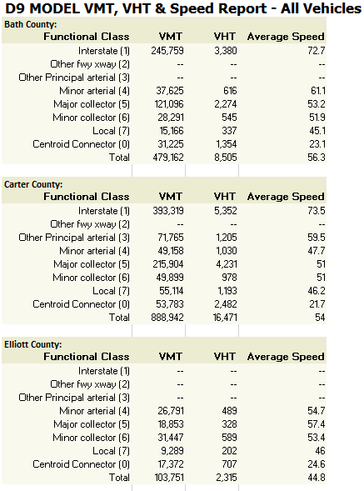
Regional Model – System Performance
Example Report
Reports by
All vehicles
Auto
SU truck
COMB truck
Total truck
Each series includes (by county & by functional class)
VMT
VHT
Average speed

Slide 26
Summary of Findings
Regional Models represent our state of modeling practice for macro models in Kentucky.
KYTC’s standardized procedure makes travel demand modeling use consistent, transferable techniques between areas, and flexibility to improvements.
OD data from AirSage is useful and cost-effective particularly for trip distribution, time-of-day and directional factors. AirSage adaptable to develop area type factors for trip generation. AirSage trip tables refinement & adjustment essential.
Estimation of medium (SU) and heavy freight (COMB) truck trip generation significantly improves zone splitting. Truck model can be adjusted to match available information.
The NCHRP 716 approach for external trip estimation works well for study areas with rural boundary in Kentucky.
Model parameters are transferable between areas in Kentucky as initial values. HBW trip rates, friction factors of internal person trips & external truck trips, and TOD factors can be adjusted for area-specific values.

Slide 27
Questions ?
Scott Thomson, PE
KYTC
Scott.Thomson@ky.gov, 502.782.5086
Jayalakshmi Balaji, PE
KYTC
Jayalakshmi.balaji@ky.gov, 502.782.5045
Ken Kaltenbach, PE
Corradino
kkaltenbach@Corradino.com, 502.587.7221
Johnny Han, PhD, PE
Corradino
jhan@Corradino.com, 317.744.9858

Slide 28
Using KYTC Regional Models
Presented to
The Kentucky Model Users Group
Presented by
The Corradino Group
Frankfort, KY
April 18, 2016

Slide 29
Outline
KYTC’s Model User Agreement
Network Flexibility
Speed & Capacity Adjustment
Zone Splitting
Truck Model Adjustment
Select Link Analysis
OD data

Slide 30
KYTC’s Model Transfer
Models are initially developed by consultants under KYTC’s guidance
Models comply with KYTC’s standardization
Models are enhanced by KYTC and consultants as needed upon KYTC’s model review (this could be a few rounds)
Key to Success
KYTC’s Standardization
Shared Resources
Effective Communication & Coordination between KYTC and Consultants

Slide 31
Network Flexibility
Field In_Network is used to control link usage by vehicles.
Null or 0 = inactive links (not used by model)
1 = active for all vehicles
2 = active for auto only
3 = active for truck only

Slide 32
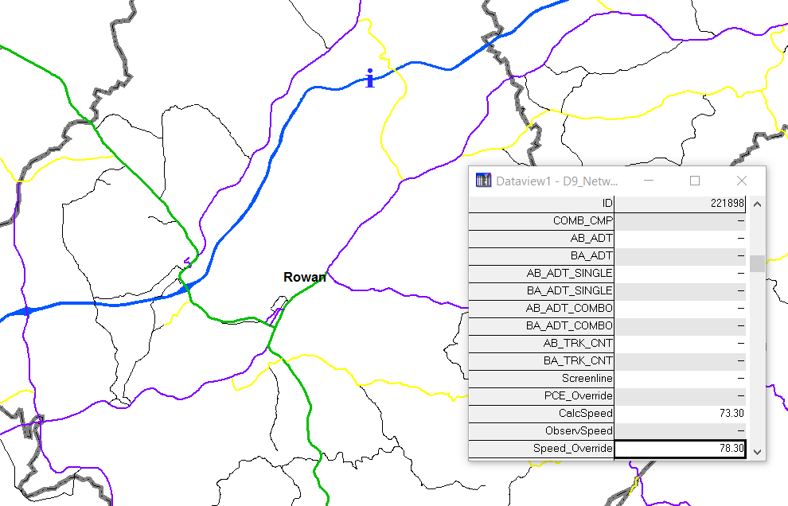
Speed/Capacity Overrides
Network fields Speed_Override and HourlyCap_Override (AB/BA) are used to override free-flow speed & capacity calculated by HCM 2010 methods as needed
3rd party data source
Improved model calibration/validation

Slide 33
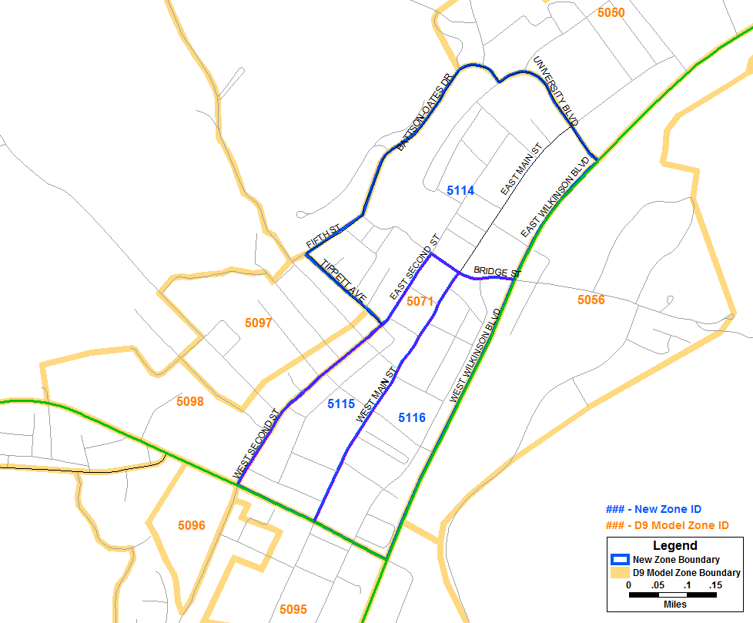
Zone Splitting
Split Zones (based on homogeneous land use)
Update zonal SE data (ensure original zonal totals equal the sum of all subdivisions)
Update network (ensure new centroid IDs match new TAZ IDs)

Slide 34
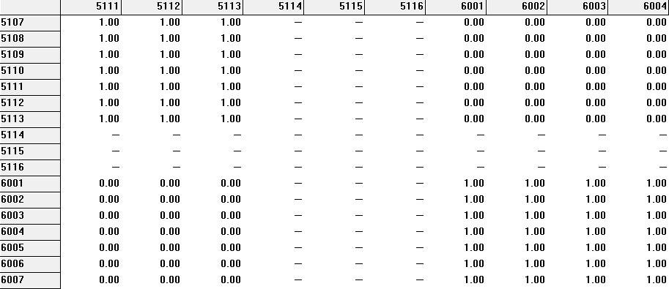
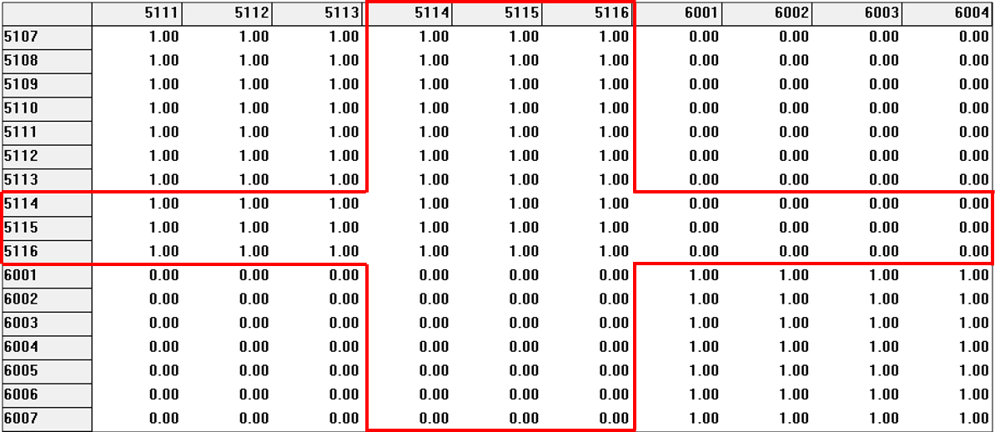
Zone Splitting
Update K-factor matrix
Used by HBSchool trip distribution
Value = 1 or 0 (intra-county OD flow or not)
Matrix dimension must match TAZs
Improved approach/script reduces error reporting caused by matrix dimension issues

Slide 35
Truck Model Adjustment
Truck Generation Rates
QRFM II – starting point
Adjusted by ODME
Internal Truck (non-intrazonal) | Trips by QRFM II | Target Totals by ODME | Adjusting Factor
SU Truck | 18,140 | 23,763 | 1.31
COMB Truck | 6,369 | 11,323 | 1.78
Truck Special Generators
TAZ fields SG_MdTrk & SG_HvyTrk
Represent zonal additive truck trips (+/-)
final trucks = initial trucks + 0.5 * SG_MdTrk or SG_HvyTrk
Useful in model calibration

Slide 36
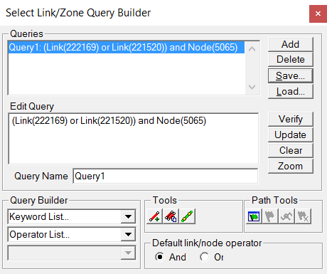
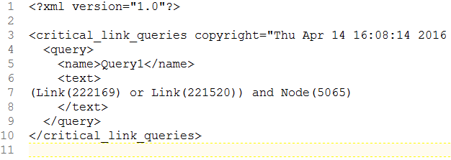
Select Link Query Options
Select Link Analysis – show where the traffic that pass through a specified set of links/zones go to and/or come from.
2 ways to define select links/zones
TransCAD Select Link/Zone Query Builder
Select Link Control File ( *.qry, can be opened & edited in text editor)
And/Or operators for links & nodes

Slide 37
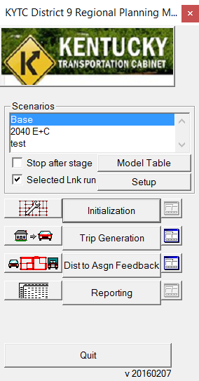
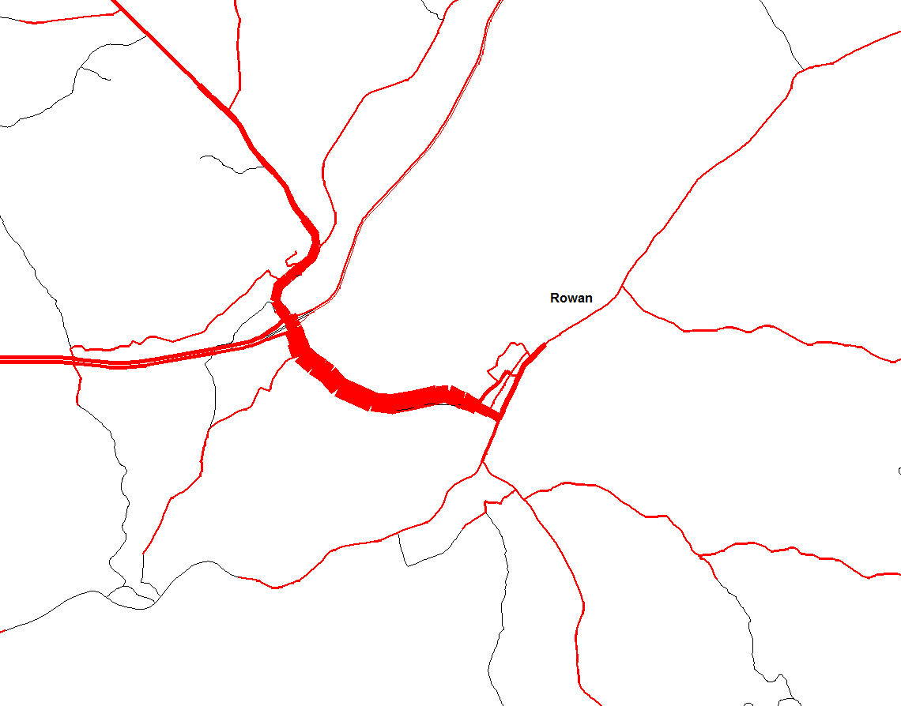
Select Link Query Options
Select Link Volume reported by
Daily
Each time period
Vehicle class (auto, SU truck, COMB truck)
Direction

Slide 38
OD - Background
No current household OD survey data. No NHTS add-on.
Lower cost compared to traditional household travel surveys.
KYTC first purchased OD data for Lexington Area MPO model
KYTC and Corradino have gained thorough insight in the use of OD data from AirSage for model development.
For District 9 Regional Model, OD data was collected using an initial 500-zone structure. (resolution limit = 0.25 mi square)
AirSage OD data provides internal-internal trips within the model area by purpose and time period. If data collection area is large enough, external trip information can be obtained from AirSage.

Slide 39
Data Pre-processing using AirSage
Create TransCAD matrix files from AirSage (.CSV)
Time Periods (Comes as five periods)
AM peak = 6:00-9:00
Mid-day = 9:00-15:00
PM peak = 15:00-18:00
Night = 18:00-24:00 & 0:00-6:00
Trip Purpose: (H-home, W-work, O=other)
HBW = HW, WH
HBO = HO, OH, HH
NHB = WO, OW, WW, OO
The 500-zone OD table is used for trip generation, time-of-day and directional factor analysis. A refined 620-zone OD table (the final internal TAZs) is used for friction factor development.
Notes:
The 620-zone OD table is refined based on census household & employment (LEHD) data.

Slide 40
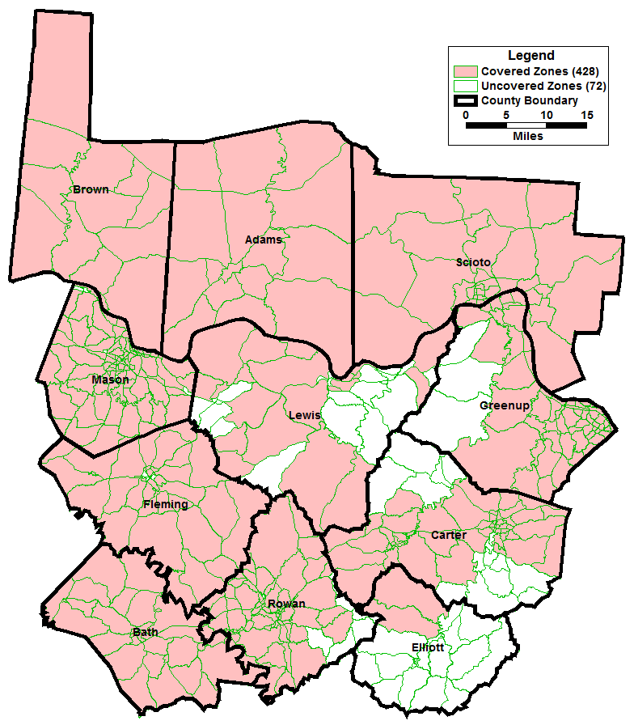
AirSage – Coverage Assessment
85% of 500 zones had data.
Uncovered zones are typically in rural areas with low population (7% of area in the District 9 model)
Uncovered areas are a function of poor cellular service
 | Covered Zones | Uncovered Zones | Total Zones
Origin Zone | 426 | 74 | 500
Destination Zone | 426 | 74 | 500
O + D Zone | 428 | 72 | 500

Slide 41
AirSage – Cautions
AirSage trips by purpose must be evaluated. Will effect trip generation rates.
Analysis is generalized due to resolution limits & aggregate data.
AirSage can provide trip data that is normalized to census population as well as multiple carriers. With multiple carriers, averaging the two sets minimizes data bias.
Initial AirSage OD table needs refinement (an ODME process is recommended) before analysis
Purpose | AirSage |  | Calibrated D9 Model
 | Internal P's | Internal A's | Internal P's | Internal A's
HBW | 118,429 | 118,429 | 160,704 | 159,215
HBO | 654,781 | 654,781 | 466,274 | 484,083
NHB | 355,881 | 355,881 | 258,846 | 250,000
Total | 1,129,090 | 1,129,090 | 885,824 | 893,298
Daily I-I Person Trip/HH | 9.6 |  | 7.6

Slide 42
AirSage – Trip Length Distribution
Refined AirSage data yields reasonable TLFD & mean trip lengths.
AirSage mean trip length
HBW – 16.8 min
HBO – 13.3 min
NHB – 15.3 min
Friction factors are developed for HBW, HBO and NHB, using TransCAD’s gravity model calibration function.

Slide 43
Questions ?
Scott Thomson, PE
KYTC
Scott.Thomson@ky.gov, 502.782.5086
Jayalakshmi Balaji, PE
KYTC
Jayalakshmi.balaji@ky.gov, 502.782.5045
Ken Kaltenbach, PE
Corradino
kkaltenbach@Corradino.com, 502.587.7221
Johnny Han, PhD, PE
Corradino
jhan@Corradino.com, 317.744.9858

